Slide 1
Without Chunk numbers changing cmake Dcmake_build_type =release add this flag on cmake command line

Slide 2
unmodified rotate

Slide 3
modified rotate

Slide 4
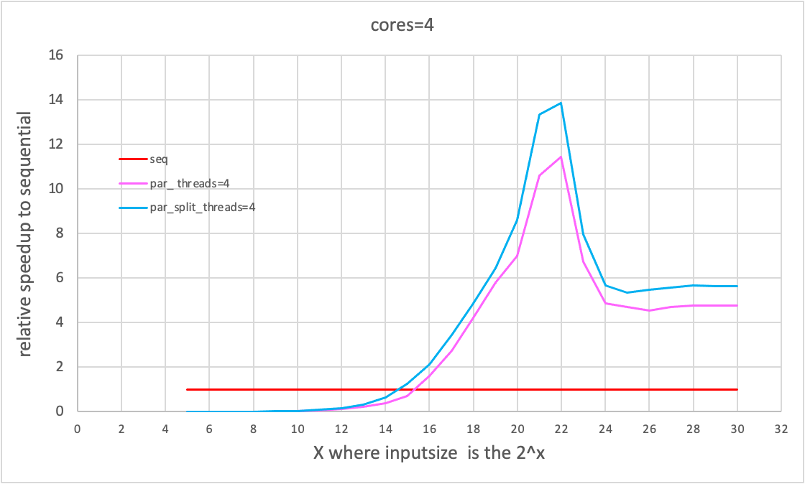
modified rotate Vs. unmodified rotate
the modified rotate has better performance at lower and higher end on each core
improvement: 21.5%

Slide 5
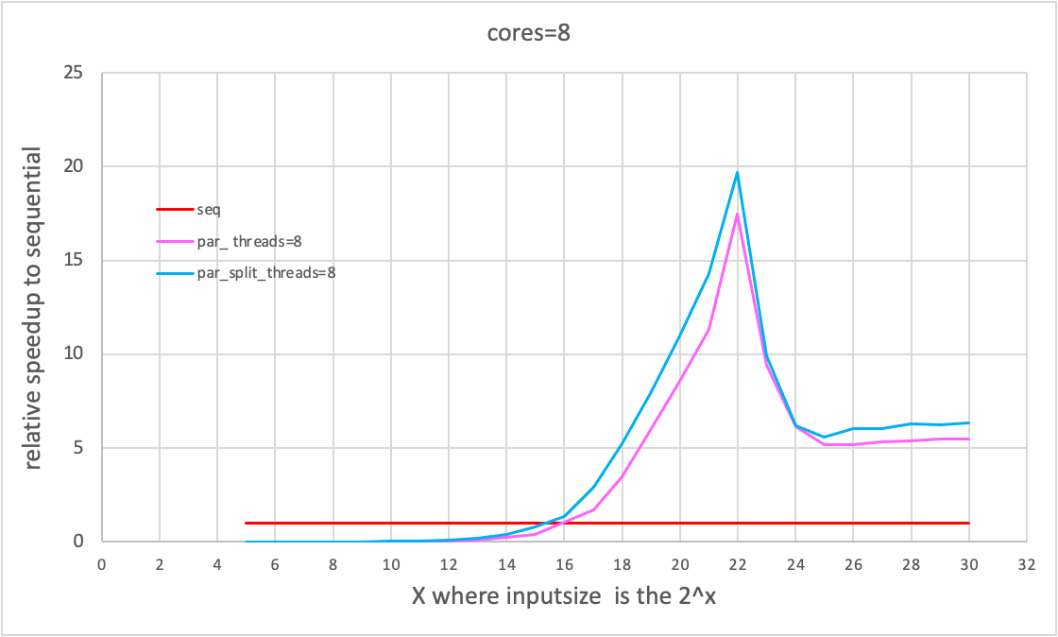
improvement: 12.6%

Slide 6
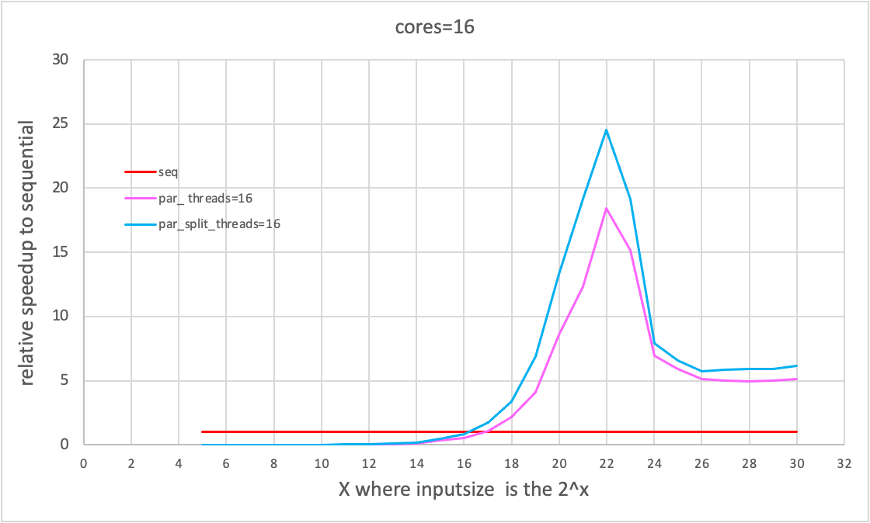
improvement: 33.2%

Slide 7
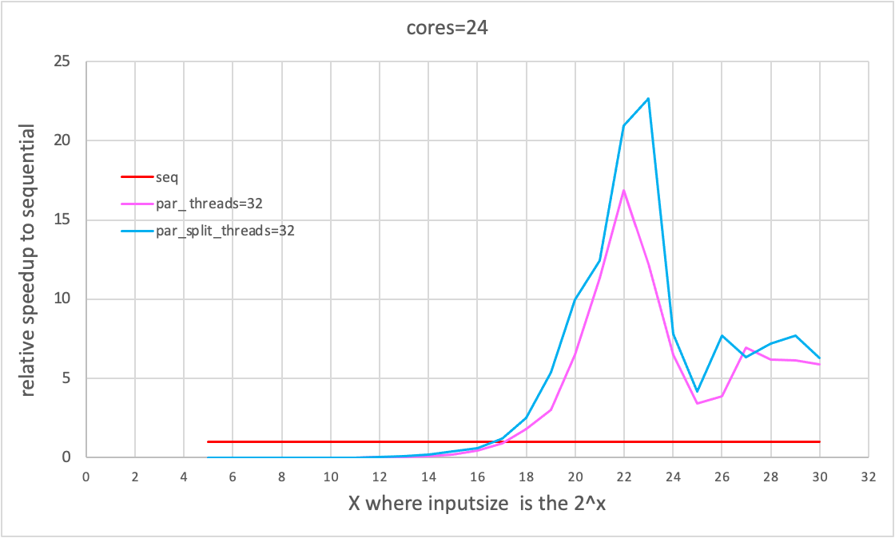
improvement: 35%

Slide 8
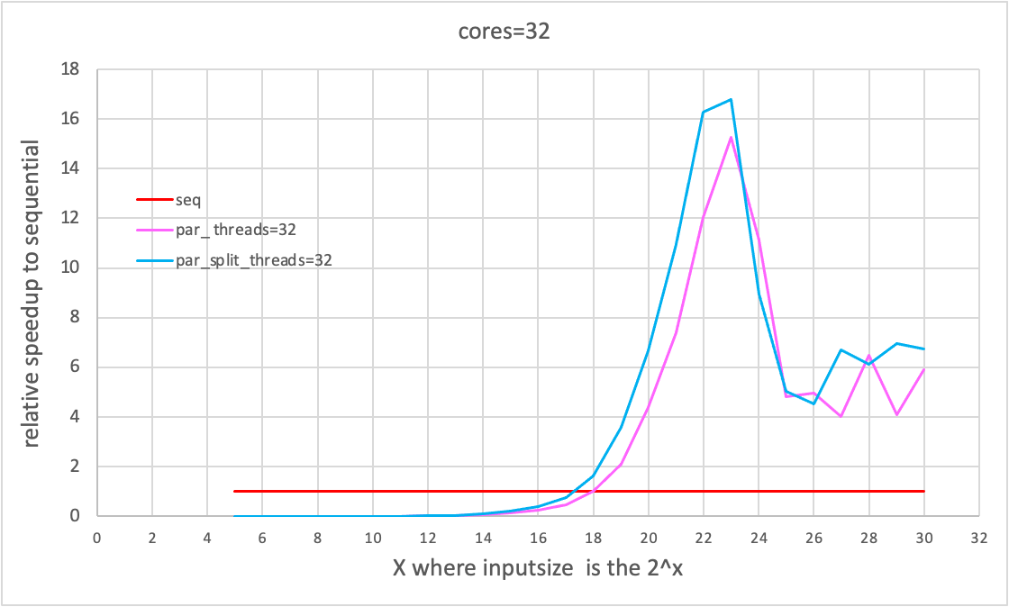
improvement: 10%

Slide 9
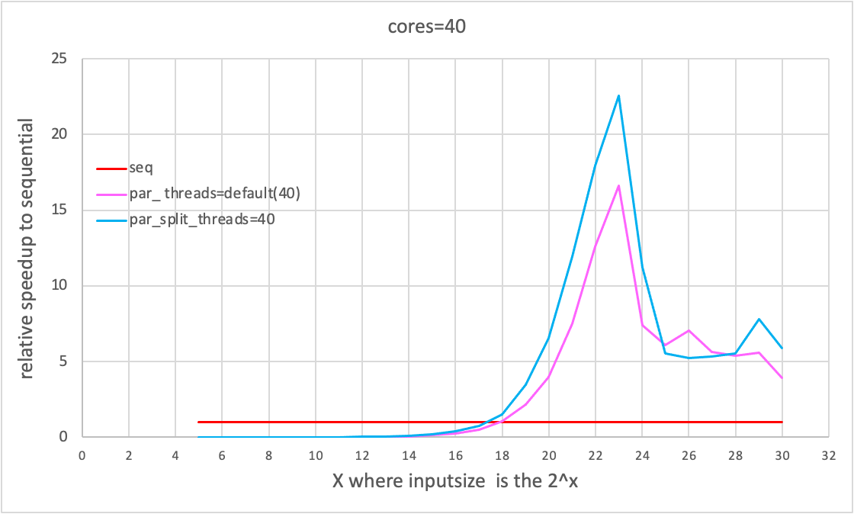
improvement: 35.5%

